Slide 1

BCI Project-task 2
Giulio Lecci 1000002090
Dataset: s27

Slide 2

Project Specifications
Analysis of EEG signals, recorded on 52 people (19 females and 33 men).
Signal composed of 64 channels with electrodes placed as the 10-10 International system.
Biosemi ActiveTwo system used as recording device with a sample rate of 512 Hz.
Subjects are asked to compute motor imagery trials, so to imagine hand movements basing on the instruction given. Hence, this is an Active BCI system (as reported in the device used).

Slide 3
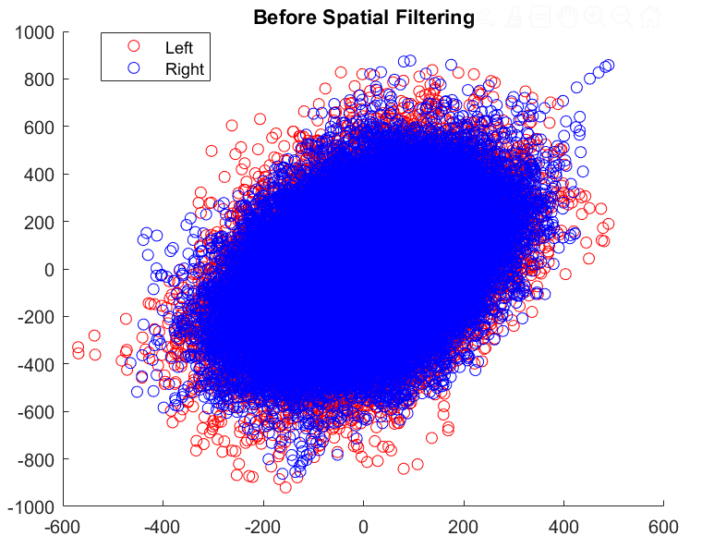
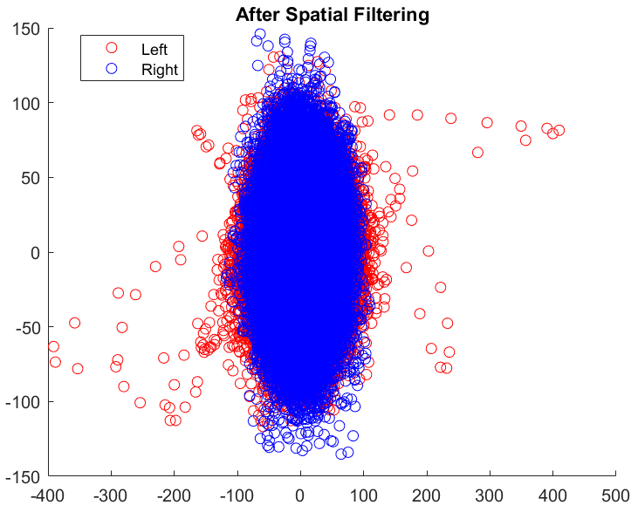
Common Spatial Pattern application
Starting from the "purified" filtered dataset obtained from the task 1, where every rest phase between each motor imagery trial and even some bad trials have been deleted.
The common spatial patter method has been applied in order to reduce the dataset complexity because with CSP the dataset dimension goes from 64channels to only 2 features that contain all the variance information of the 2 classes that have to be identified.
Note how the first plot (before CSP) shows highly correlated data in which both classes extend in the same direction while, after the spatial filtering, both classes "try" to extend in different directions. But, due to the high similarity between right and left data, the 2 classes still result very similar and are not so detached in the space.

Slide 4
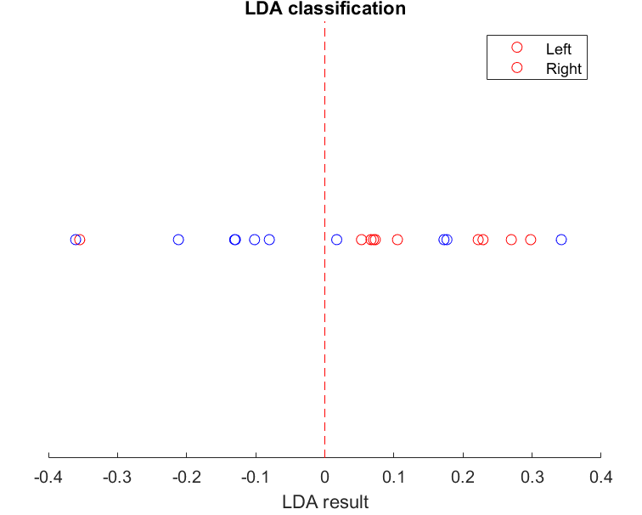

Linear Discriminant Analysis application
After the CSP (that, being applied after the filtering process, takes data with 0 mean) the linear discriminant analysis has been applied to classify each epoch as part of the right or left classes.
The classification is based on the sign of the g function that takes as input a set of samples (one or more epochs) and returns a value that will be positive or negative basing on the predicted class label.
This method, just like the CSP, decreases the dataset dimension (that is now equal to one) and then predicts the class label basing on a line that divides the 2 classes.
It's physiologically correct that a subject is not symmetric (just think about being right or left-handed) so a class may result easier to classify with respect to the other one.

Slide 5
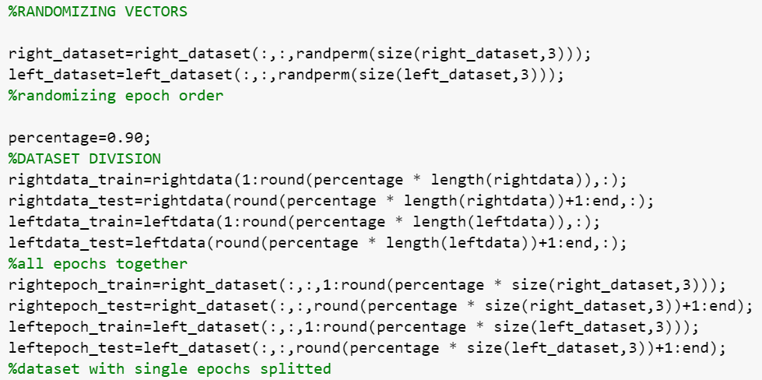
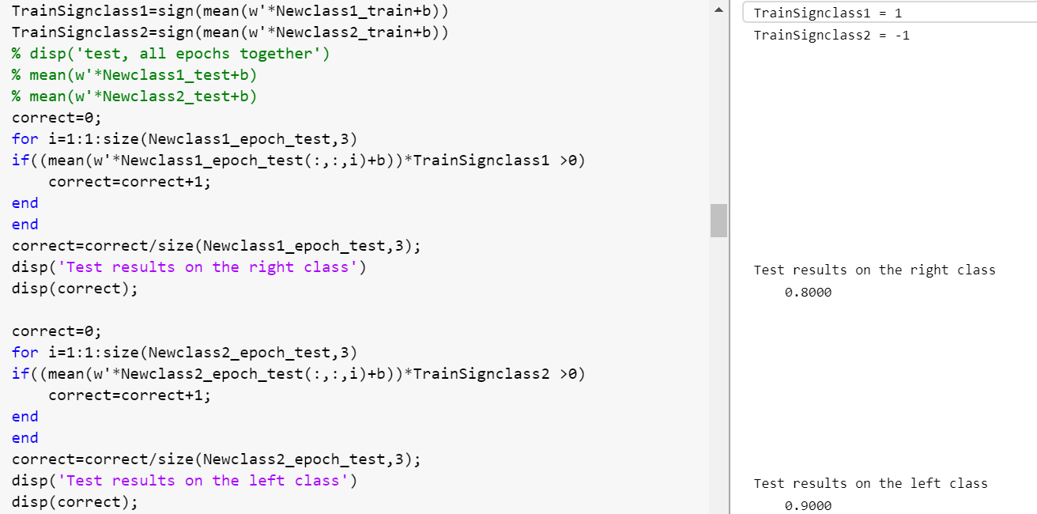
Training and testing phase separation
The entire dataset has been divided into training and testing dataset basing on a chosen percentage (several values have been tried). The main difference between those 2 sets of data is that the test one is unlabeled, so the model doesn't know the belonging class of every trial. While the training dataset has labels since the linear discriminant analysis is a supervised learning method.
Both spatial filtering and LDA procedures' parameters are evaluated on the train dataset and once the spatial filter vector and the g function have been calculated, they are applied to the test dataset.
Accuracy percentages of both classes have been calculated in the reported script, since the dataset division has been randomized different values can be obtained each time the program runs.
This execution shows an 80% accuracy for the right class and 90% for the left one

Slide 6
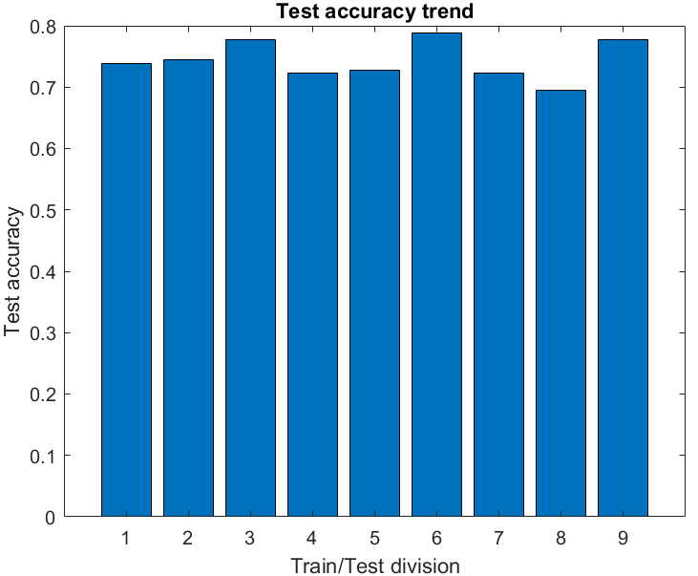
Accuracy trend
Looking at the test accuracy trend plot, that shows different values of the obtained test accuracies as the percentage of division between train and test set changes (from 10%-90% to 90%-10%), it can be seen how not necessarily the bigger is the train set the higher will be the final accuracy of the model.
This happens because the linear discriminant analysis method works better when the class means are well separated but this is not the case since right and left motor imagery trials are very similar one to the other as it can be foreseen just by looking at the CSP results.

Slide 7
Conclusions
Inspecting the classification results and "playing" a bit with parameters an important event takes place:
As said before, the classification is based on the sign of the g function computed with the LDA method. It may seem logical to think that for a chosen class, the computed sign is always the same. But this is not true.
Changing the percentage of division between test and train dataset, it may happen that a class that was first associated with the positive sign of g will be then associated with the negative sign of the same g function.
This happens, once again, because the two classes are way too similar one to the other and it may happen that, when computing the mean of each class, those values will result slightly bigger (or slightly lower) compared to the global mean between those 2 classes. This will cause one of them to be associated with the positive value of g and the other to the negative one. But since the 2 classes are so similar, also their means will be similar and, basing on the percentage of division, it can happen that the bigger mean is not always related to the same class.

